Slide 1
ArchaeoCore So Far
VRA Denver
March 12, 2015
Notes:
In January, Lucie Stylianopoulos attended a meeting in East Lansing to discuss the NEH grant recently awarded to Michigan State to build archaeological metadata. She is sorry she couldn’t be here to report, but she sent me.
Michigan State has a 3 year National Endowment for the Humanities grant to redesign ARCS and apply ArchaeoCore as the base metadata schema.

Slide 2
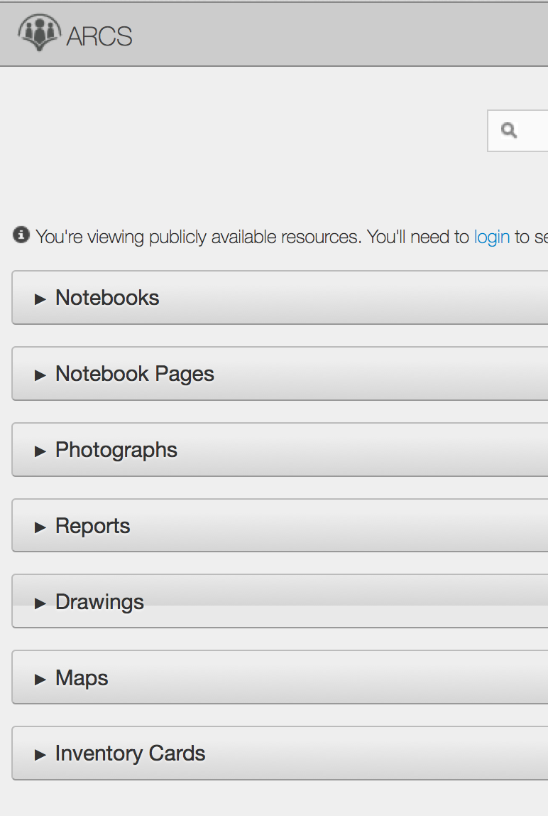
Archaeological
Resource
Cataloging
System,
Michigan State University –
arcs.cal.msu.edu/
Jon Frey, PI, MSU
Ethan Watrall, PI, MSU
Notes:
Archaeological Resource Cataloging System
Michigan State have tried ARCS using with Dublin Core on their data and weren't happy with it. So they went looking for a new data model and chose ArchaeoCore.

Slide 3
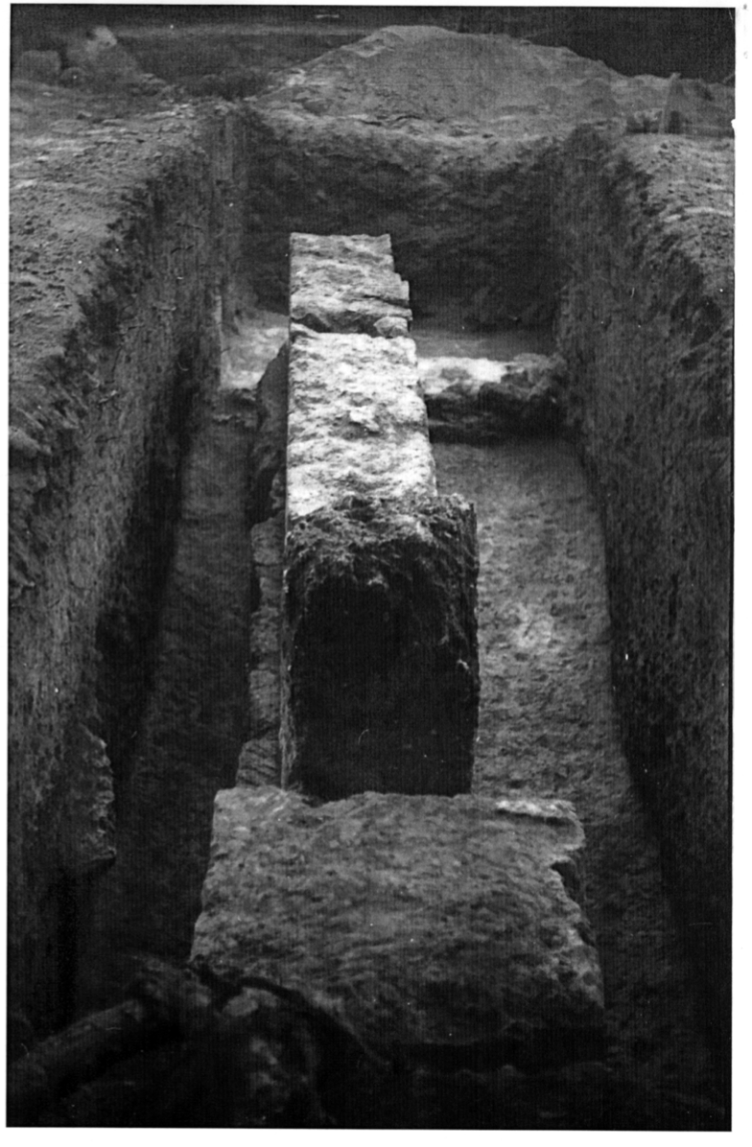
Notes:
This series of images was provided by Jon Frey from a dig in Isthmia
Jon Frey is the co-director of the Isthmian excavation with Tim Gregory of Ohio State
This is a trench

Slide 4
Notes:
Isthmia: A notecard with photograph and description of a find

Slide 5
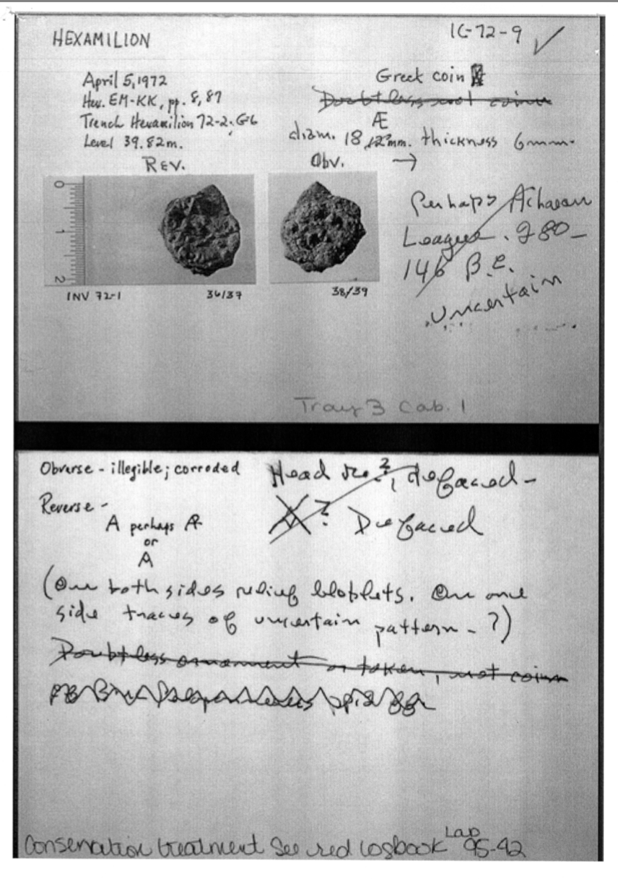
Notes:
Notecard about a Greek coin
The point of Frey's illustration sample is that they have photographs, notebooks, drawings within the notebooks, databases containing photographs, scanned index cards, etc. in at least three different languages, a selection of artifacts accessioned a different way, coins accessioned another different way; they need to aggregate all this data in some way and that is what ARCS will do.

Slide 6
Year 1
Isthmia
Year 2
Polis site
Chersonese
Year 3
Availability to other sites
Archival Nemea
Linked Open Data
Notes:
1st year -- they will take all data from Isthmia, digitize any not already digitized and put it all into the ARCS system.
2nd year -- they will do the same for another of the excavations in Polis in Cyprus (Bill Caraher, NDakota) and Chersonese in the Crimea. Crimean material is at Texas, not available in the Crimea.
3rd year -- ARCS will be available to other sites and Michigan State group will work on archival material at Nemea in Greece. At this time they will begin the development of a linked open data solution.

Slide 7
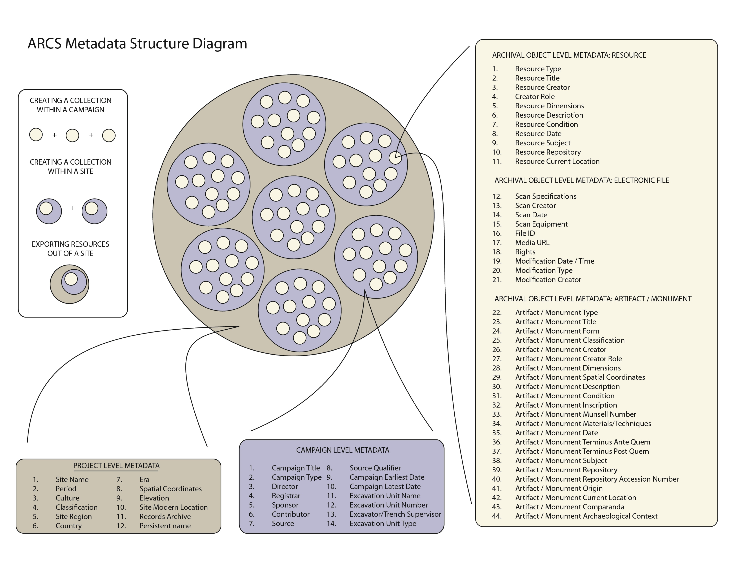
Notes:
Structure diagram: shows the way they are conceptualizing their data. They felt they needed more material about the resource type. This diagram conflates artifact and monument into the same set of fields, but by the time they talked it through they were coming around to the idea that artifact and monument need to be separate sets of fields

Slide 8
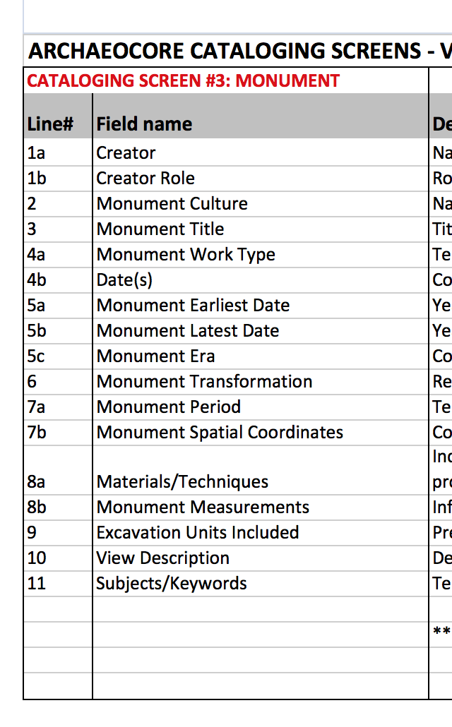
Notes:
There is a lot of interest among excavators and scholars in the domestic setting, so situating the artifacts within their domestic context is vital -- public and domestic artifacts tend to be different and domestic artifacts tend to be more instructive; we found this to be true with the Flowerdew material so we came up with this set of monument fields

Slide 9
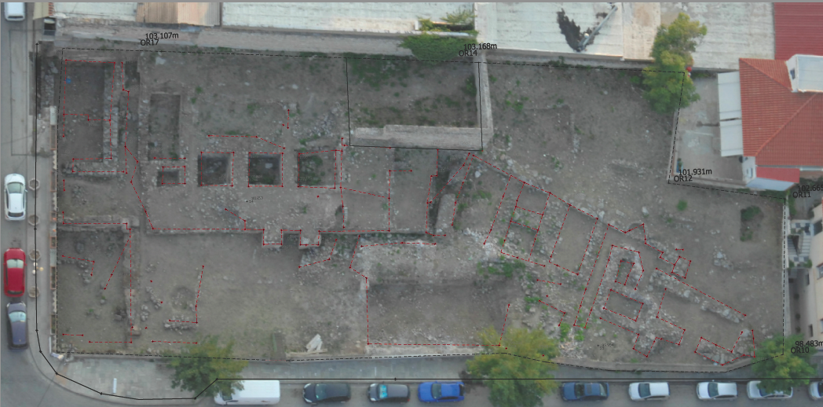
Monument fields
Notes:
From the original House of Kadmos site that produced extraordinary amounts of Bronze Age material
Opportunity to describe objects on the site and understand the setting
In other news: ArchaeoCore is part of a new grant proposal in Greece; no news yet on that.
Sean Tennant, UVA doctoral student in classical archaeology, and Lucie will be returning to Greece for a few weeks in June to work on a different site and on the Thebes Kadmeion, with Fotini Kondyli (Classics Dept., UVA)
Sean will also be at Isthmia to help set up the site and campaign records for that Shared Shelf project

Slide 10
PG64 Stone House Foundation site
Almost 1000 records in Shared Shelf and 644 images
Maps and plats have been scanned and described
The Site and Campaign records have been developed
Next is artifact cataloging
Notes:
Update on Flowerdew: Images are primarily on-site photographs (slides)
With the site and campaign records in place, artifacts will be able to be cataloged at a faster pace.
Anne Gaynor (Metadata Librarian, UVA) is going to work on an ontology for linked open data for ArchaeoCore, using Flowerdew

Slide 11
ArchaeoCore website
http://www.ifaresearch.org/archaeocore/index.html
Notes:
Has the latest version of the schema; I will be adding previous versions of the schema to the website in the coming weeks.
Any questions? Does anyone else have any ArchaeoCore news they’d like to talk about?

